Slide 1

Index-based Insurance:
Financial Innovations for Development and Conservation
Christopher B. Barrett
Seminar at Monash University
May 20, 2012

Slide 2
The Potential of Index-based Insurance
Environmental and economic costs of uninsured (weather and natural disaster) risk, especially w/ threshold-based traps
Insurance → protect rural livelihoods and escape poverty:
  Provide safety net to prevent collapse of vulnerable populations
  May encourage investment and asset accumulation by the poor
  May induce financial deepening by crowding-in credit market and reinforcing social insurance arrangements
Insurance → pre-finance rapid rehabilitation and recovery:
  Timely response enhances resilience to shocks and prevent system collapse or reduce the costs of humanitarian response
If shocks are strongly linked to livelihood and ecosystem dynamics, insurance for cash-for-conservation work can offer
  Productive safety net for both people and endangered species

Slide 3
The Potential of Index-based Insurance
Conventional insurance unlikely to work due to transaction costs and incentive problems (moral hazard and adverse selection)
Index insurance w/ indemnity payments based on an index
  Objectively verifiable, available at low cost in real time
  Not manipulable by either party to the contract
  Strongly correlated with risk being insured
  No transactions costs of measuring individual losses
  Preserves incentives (no moral hazard or adverse selection) as insured cannot influence index performance
  Available on near real-time basis: faster indemnity payment for more effective recovery response
Prerequisite: strong correlation established from sufficiently high-quality data of insurable risk (the index)

Slide 4
The Challenges of Index Insurance
‘Big 5’ Challenges of Sustainable Index Insurance:
  High quality data (reliable, timely, non-manipulable, long-term) to calculate premium and to determine payouts
  Minimize uncovered basis risk through product design. Insurance or lottery ticket? All turns on basis risk!!!
  Innovation incentives for insurance companies to design and market a new product and global market to support it
  Establish informed effective demand, especially among a clientele with little experience with any insurance, much less a complex index-based insurance product
  Low cost delivery mechanism for making insurance available for numerous small and medium scale producers

Slide 5
Solutions to Challenges
  High quality data:
    Satellite data (remotely sensed vegetation: NDVI), early warning system data (child MUAC), weather station data
  Minimize uncovered basis risk:
    Analysis of household/child/species data to calibrate index
  Innovation incentives for insurers:
    Researchers do product design work, develop awareness materials and assist with capacity building
  Establish informed effective demand:
    Simulation games with real information & incentives
  Low cost mechanism:
    Delivery through commercial partners using ICT

Slide 6
Three Examples
1) Index-based livestock insurance (IBLI) to address poverty traps in east African rangelands
2) Famine insurance to pre-finance humanitarian response to drought in east Africa
3) Cash-for-conservation to address windstorm threats to hornbill conservation in southern Thailand
Notes:
6

Slide 7
Example 1: IBLI
New commercial IBLI product launched commercially in January 2010 in northern Kenya
Based on technical design developed at Cornell, refined and led in the field by the International Livestock Research Institute (ILRI) in collaboration with university and private sector partners.
Adapted version about to launch in Ethiopia. Being adapted to new areas in Kenya.
See Chantarat et al. J. Risk & Insurance forthcoming
Notes:
7

Slide 8
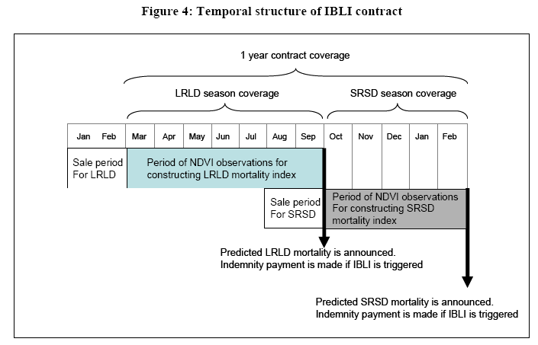
IBLI Product Design
Temporal structure of 1-year contract (2 seasonal coverage):
Seasonal insurance payment based on mortality index:
Notes:
8

Slide 9

IBLI Outreach and M&E
Field insurance game to generate informed demand
  Financial educational tool
  Learn subjects’ response to product
  Build demand for IBLI
Integrated long-term survey design for impact evaluation to inform program and policy formation
  Multi-year HH survey w/encouragement design: study behavioral and welfare impact (incl. in comparison with cash transfers)
Notes:
9

Slide 10
Example 2: Famine Insurance
Current stage of emergency response
Goal: Use index insurance to pre-finance effective response to severe droughts
3 - 6 months
Time
Seasonal rains fail /EWS alert
Assess
Appeal
Aid arrival
Time
Appeal for insurance premiums
Seasonal rains fail /EWS alert
(triggers insurance payout)
Aid arrival
(insurance payout)

Slide 11
Example 2: Famine Insurance
NGO/gov’t policy holders choose threshold wasting level, then seasonal rainfall distributions and estimated iso-food insecurity curve jointly price the insurance.
See Chantarat et al. AJAE 2007, AFR 2008
Notes:
11

Slide 12
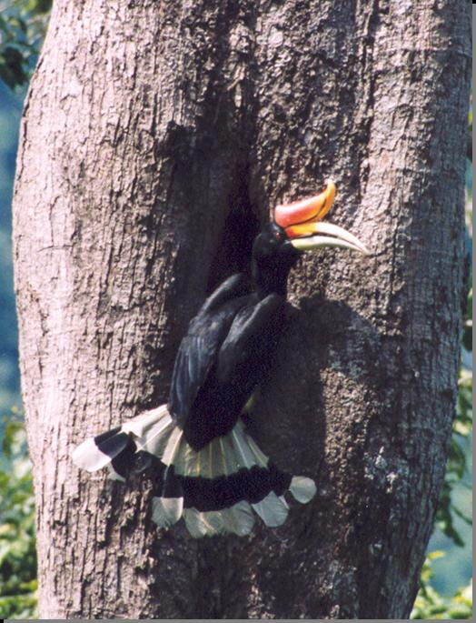
Example 3: Hornbills Conservation in Thailand
Budo Su-Ngai Padi National Park (BSNP): Mountainous, tropical rainforest vulnerable to wind storms
Home to 6 endangered species of hornbills
Nesting season (Feb-Sep) each year
Population recruitment relies on
(1) Availability of suitable nesting trees
  - Holding capacity for breeding pairs
  - Storms key cause of irreversible loss
(2) Breeding condition free of disturbance
  Key threat: extensive human disturbance (poaching, forest clearance), some induced by coping responses to adverse income shocks as key threat to breeding success
  See Chantarat et al., PNAS August 2011

Slide 13
Example 3: Hornbills Conservation in Thailand
Home to Muslim minorities (among Thailand’s poorest groups):
Hornbill research foundation and
conservation project (since 1994):
Poverty rates ($1.25/day) ~ 43-89%
Forest/rice livelihoods,
vulnerable to wind shocks
Collect annual data on nest
and reproduction variables
Focus on nest modification and
replacement (e.g., artificial nests)
Extensive community involvement
aiming to reduce human disruptions

Slide 14
Example 3: Hornbills Conservation in Thailand
General Framework:
Accumulation of nest trees
Irreversible nest tree loss
Effective nest recovery response
Wind-based index
Insurance for nest tree
based on
Hornbill population dynamics
Strong winds
shock
Community-based
nest recovery program
Rural village consumption
Reduce human disturbance
Induced by adverse
Consumption shock

Slide 15
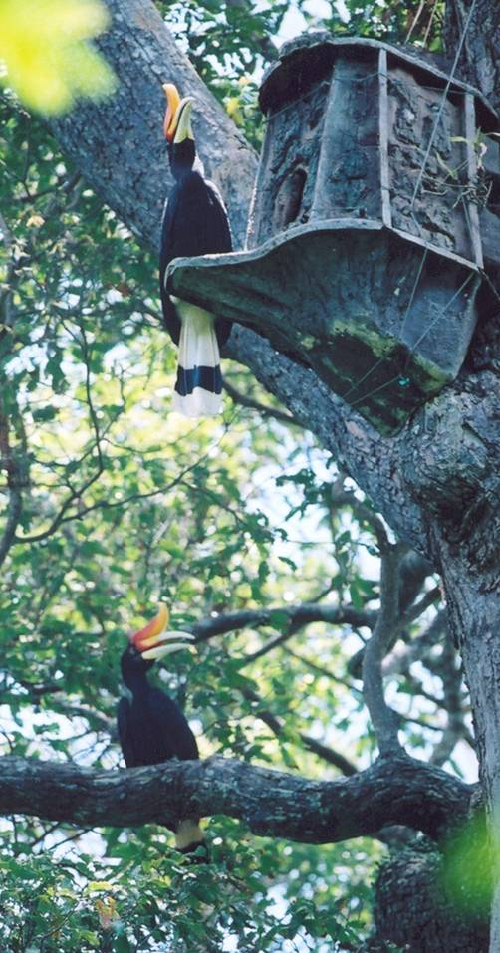
Example 3: Hornbills Conservation in Thailand
How would this insurance work?
Conservation project can insures any T nest trees
If wind-based nest loss index exceeds strike l*, insurance payout can finance rapid community-based nest replacement (e.g., artificial nests)
c: total replacement cost per tree nest (artificial nest =$400, installation and annual monitoring by local villager = $600, which goes directly to villager)

Slide 16
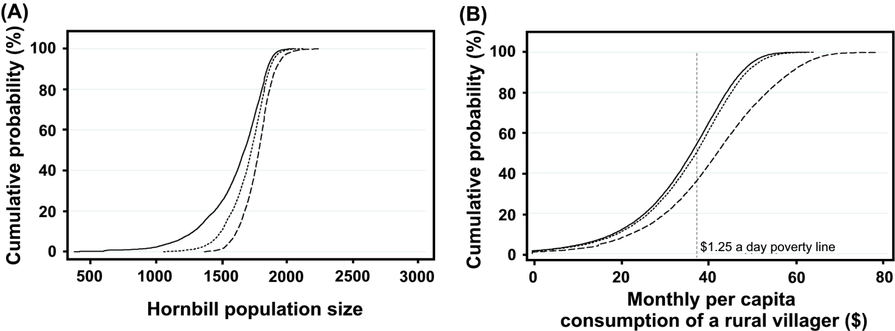
Example 3: Simulated Impacts
Assume that project insures all nest trees at the beginning of any year t, and that each villager receives $600/12 = $50 for full installation and monitoring of an artificial nest
5% contract reduces pr(flock collapse) below initial size (1096) by from 80% to 60% and eliminate prob. of collapse below 75%.
It would reduce poverty headcount ($1.25/day) by 20%
Cumulative distributions of 1000 replications of 100-yr simulated dynamics
(line= no insurance, dash = 5% strike contract, dot = 15% strike contract)

Slide 17
Conclusions
Index-based insurance offers promising new options to develop risk management for conservation and poverty reduction in low-income rural areas underserved by traditional insurance. But look at basis risk more carefully (insurance or lottery tix?)
Key needs going forward:
Good data sources
More discriminating design (basis risk, assets)
Technical capacity dev’t among field partners
Competition in reinsurance markets
Public financial education and careful M&E
Notes:
17

Slide 18
For more information
On the IBLI case:
Visit web site: http://www.ilri.org/ibli/
On other index insurance innovations:
Visit http://aem.cornell.edu/faculty_sites/cbb2/
and http://i4.ucdavis.edu/
Thank you for your interest and comments!
Notes:
18

